Slide 1
Microprocessors ‘PROJECT’ {
Microprocessors_Course.asm
Operations on an Array[NUMBERS]
< using x86 Assembly >
}
Under the supervision of Dr. Abdelhamid & Eng. Ahmed Bakr

Slide 2
Members
1
2
3
4
5
TEAM 4
ARSANIOUS ISAAC
CLARA RAEF
MARK MAGDY
https://github.com/arsanious-isaac
https://github.com/Clara-Raef
https://github.com/markmagdy822000
Project Repository
https://github.com/Clara-Raef/Team4-Microprocessors-Project
MINA NAGY
YOUSSEF NAZEER
https://github.com/MinaNagyLatif
https://github.com/Yousef-nazeer

Slide 3
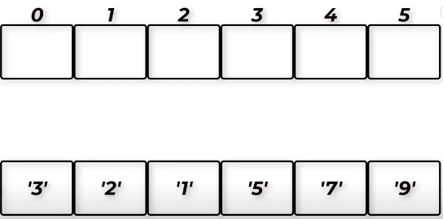
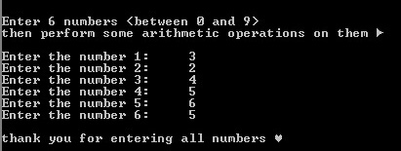
Project Description
This project was coded using most of the x86 assembly language we learned throughout the course.
What the code does is perform certain operations on an array of 6 numbers. The user is asked to enter these numbers digit by digit.

Slide 4
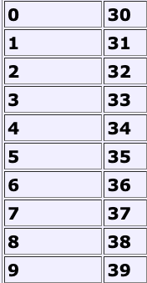
Input
Numbers input by the user are stored as ASCII characters and transformed into integers during the operations.

Slide 5
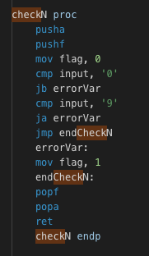
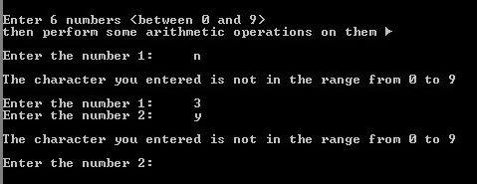
Check_Number.asm
The program makes sure the user has entered 6 digits within the range 0 - 9

Slide 6

THE OPERATIONS
The user is free to choose any of the 11 operations provided by the program, where each is denoted by a specific character:
Average ➣ ‘v’
Maximum number ➣ ‘x’
Minimum number ➣ ‘n’
Descending order ➣ ‘d’
Ascending order ➣ ‘a’
Standard deviation ➣ ‘e’
Summation ➣ ‘s’
All operations ➣ ‘l’
Quit program ➣ ‘q’
Re-enter 6 digits ➣ ‘r’
Help ➣ ‘?’

Slide 7
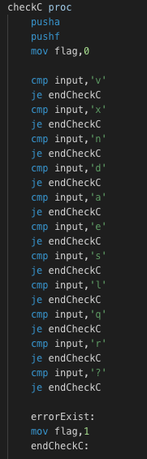
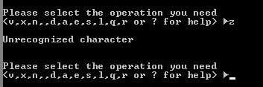
OUR COMPANY
Check_Number.asm
The program makes sure the user has entered one of the specified characters

Slide 8
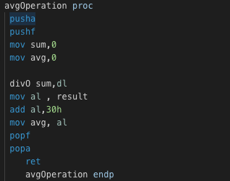
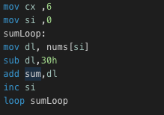
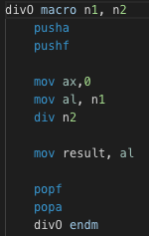
Summation & Average
SUMMATION.asm
AVERAGE.asm
Denoted by ‘s’
The output is the sum of the 6 digits in the array.
Denoted by ‘v’
Based on the summation operation
The output is the result of dividing sum of the 6 digits in the array by 6.

Slide 9
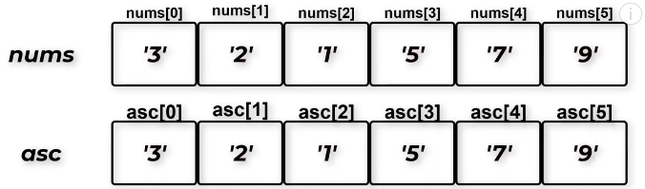
- The algorithm used is Selection Sort. There are 2 sub-arrays: one is sorted and the other is unsorted. The algorithm loops, and the minimum number from the unsorted array is found then placed in the sorted array.
Sorting.asm
- The numbers are copied into a new array on which the sorting will be performed so that we don’t make changes to the original input.

Slide 10
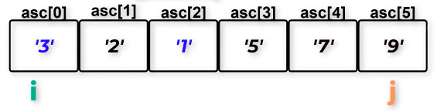
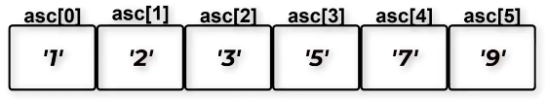
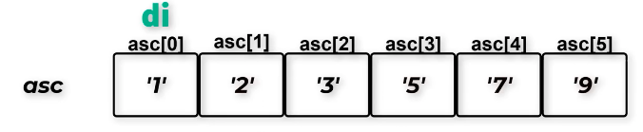
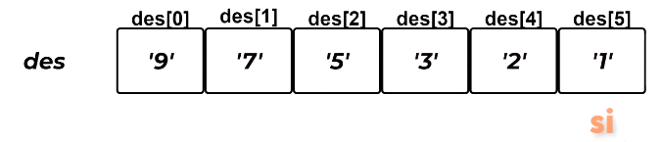
Ascending & Descending Sorting
Ascending Order
Denoted by ‘a’
The input numbers are sorted from the smallest to the greatest number.
Descending Order
Denoted by ‘d’
The ascendingly sorted numbers are reversed so that the new order starts with the greatest number and descends until the smallest number .

Slide 11
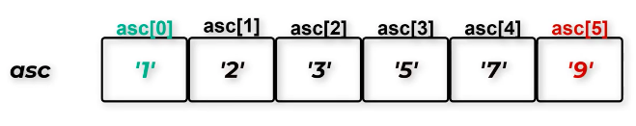
Maximum
&
Minimum
Numbers
Maximum number operation is denoted by ‘x’
Maximum number operation is denoted by ‘n’
Both depend on the result from the ascending sorting of the numbers, where the first element of the array is already the smallest number & the last element is the greatest one.

Slide 12
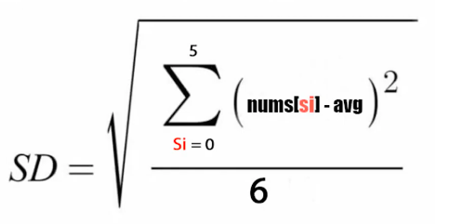
Standard_Deviation.asm
Denoted by ‘e’
This operation will need to use the summation & average operations of the program. In addition to power 2 (^2) & square root operations.

Slide 13
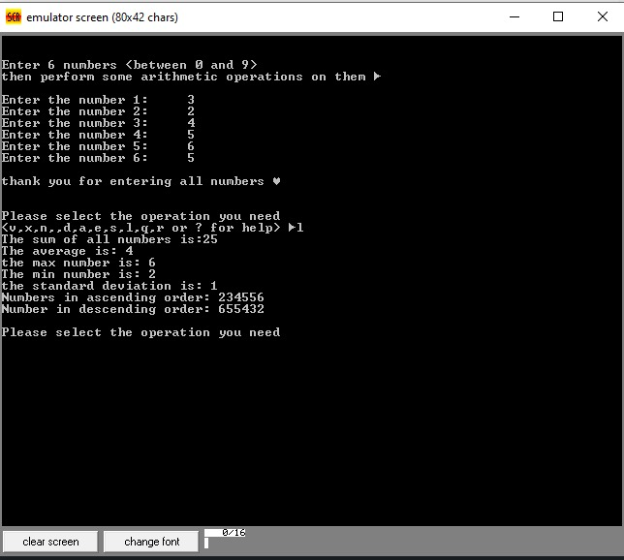
All Operations: ‘l’

Slide 14
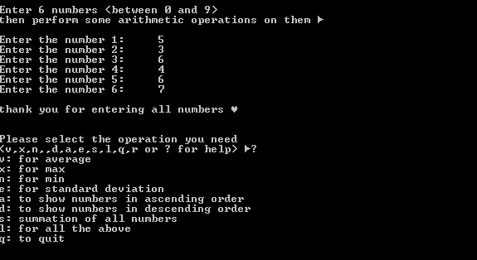
Help: ‘?’

Slide 15

RESOURCES
Irvine, K. R., & Irvine, K. R. (2011). Assembly language for x86 processors. Upper Saddle River: Prentice Hall.
Brey, Barry B.. (1997). The intel microprocessors 8086/8088, 80186/80188, 80286,80386, 80486, pentium , and pentium pro processor architecture, programming, and interfacing (4th ed). New Jersey: Prentice Hall Inc.
Assembly Tutorial

Slide 16
THANK YOU!

